Slide 1

ECAN Project – first review
Evan Yu, Cameron Schneider, Alex Hobbs, Nathaniel Tabacchi

Slide 2
Project description
Level-based puzzle game
Developed in C/C++
ncurses for graphical interface

Slide 3
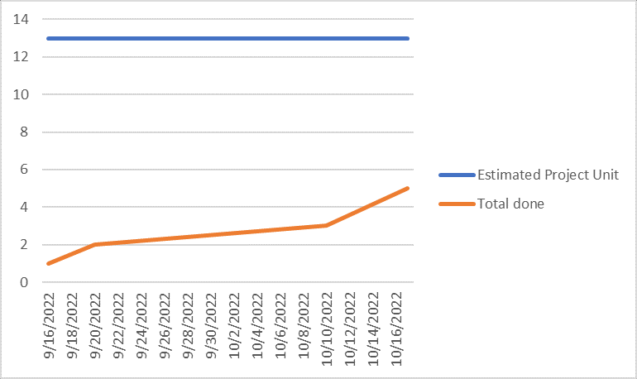
Project Timeline
Functionality for the game has not begun development yet
Order of early development
Understand how to use ncurses
Set up testing environment
Create player and develop player movement
Create simple interactable objects and let player interact with them
Develop levels with these objects in mind
New, more complex objects will be introduced, and levels will be created to include them.

Slide 4
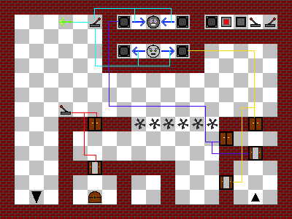

Demonstration
Artistic View
ncurses View

